Slide 1
Mission Statements
Robert Leventhal, Leadership Specialist
January 2019

Slide 2
Goals
Understand strengths and capacities
Understand environment
Connect with vital sense of purpose and your desired outcome for community
Use Mission Builder Process to create first draft of mission statement
Refine later

Slide 3
Pre-Work: Data Gathering
Fact Book Exercise Thriving Congregations Assessment

Slide 4
Building a Fact Book: What do we need to know? What can we get?
Internal Scan
Attendance
Membership by age, years as members
Enrollment in schools
Attendance at programs and services
Satisfaction
Parlor meetings- surveys
Fundraising by event
External Scan
Demographics trends
Competition
Economics of area
Lifestyle of community
Competitive substitutes
Schools
You may take this info from a placement application
Studies, articles, interviews about outside community,
Jewish trends, other kehillot
Contact your KRM for
the SSP Fact Book

Slide 5

Thriving Congregation Assessment Have SC and Board Complete
Debrief Process
Mark significant areas of strength with check mark
Mark significant areas of concern with a question mark- these deserve further study in SSP

Slide 6
Mission Statements Shared Purpose

Slide 7
Mission vs. Vision
Mission
Explains what an organization does to the community.
Explains the desired outcome of organizations efforts.
Important for communications
Short hand message of purpose
Edited, short, carefully crafted.
Vision
A portrait of what you hope to become
Describes what community will be doing, feeling, thinking.
Describes relationships and impact on people’s lives.
Important for inspiring your organization- secondary audience is general pubic.
Can stay in bullet form .

Slide 8


Importance of Mission Focuses on what the organization tries to do” (Drucker)
If you are a start up that is just going to focus on Just Jeans- your mission statement decision is huge.
If you are GE and you are creating a new mission to be global leader and you will not stay in any business where you are not number 1 or 2 in US - mission matters.
If you are an egalitarian Conservative Congregation that is committed to God, Torah and Israel, and is warm, welcoming and inclusive, your mission statement “as is “may not be big news.

Slide 9

Mission has special impact if it is distinctive.
Romemu (roh·meh·moo) seeks to integrate body, mind, and soul in Jewish practice. Unabashedly eclectic, we engage in body practices like yoga, infuse traditional liturgy with the energy of ecstatic chant, and ground our practice with meditation and contemplation. This is a Judaism that will ignite your Spirit.
We are a progressive, fully egalitarian community committed to tikkun olam, or social action, and to service that flows from an identification with the sacredness of all life.
We are….
A welcoming home where men and women participate equally and fully in song, dance, learning and praying
An oasis in New York City where you can focus on your heart and catch your breath
A place where we chant Hebrew prayers together, sing powerful wordless melodies, and have moments of deep silence
A space that honors insights and practices found in many eastern spiritual paths, and that offers meditation and yoga within a deeply Jewish practice
A center dedicated to a Yiddishkeit — Judaism — that opens body, heart, mind and spirit to experience greater compassion, courage, and joy in our lives

Slide 10
Mission Builder Exercise

Slide 11
Mission Statements- 25 minutes Ask Three Key Questions- Scribe responses
What do we do? What is our desired outcome?
Who are we? Whom do we seek to serve? (our members, customers and stakeholders, donors, supporters, advocates).
What would we like to be known for (our niche, position, passion)?
Optional
What Jewish values inform our efforts to serve this mission and shape how we will work together?

Slide 12

1. What do we do? What is our desired outcome?
“We encourage each individual to find their purpose. We help families of all ages to build rich meaningful Jewish lives and caring communities.”

Slide 13

2. Whom do we serve? Who is our customer?
We welcome people of all ages, preferences and backgrounds.
Our Beth Sholom home includes those who know a lot and those just beginning their learning.
We will meet you where you are.
“Everyone is welcome regardless of background. Each service is followed by a Kiddush luncheon during which congregants and guests continue the discussion of the Torah Study, catch up with friends, meet new people, and nosh on bagels and lox.”
- Pelham Jewish Center, Pelham, NY

Slide 14
2. Whom do we serve? Who is our customer?
Families and singles, divorced and widowed, young and old
Knowledgeable and just beginning
Gay and straight
Northern New Jersey, Pittsburgh Metropolitan Area
What denomination?
Egalitarian Conservative
Where is our focus?
The whole family throughout their lives

Slide 15

3. What would we like to be known for? Our niche? Our reputation?
“The little synagogue where everyone knows who you are.”
“We have always played a leadership role in the metropolitan area for social justice.”
“We are family. You will come to feel that this is your home.”

Slide 16
Explore Values Can stimulate mission language Can be a separate guide to leaders

Slide 17
Values Statements Discussion Options
1. Consider Values First- What Jewish values should shape our discussion of our mission?
2. Reflect on Mission Draft/Explore Values- Explore the values that will shape the work of our community. Go back and look at your mission draft. Do you need to insert some of these values in the Mission draft statement.
3. Present Separate Values Statement- Look at your mission, now consider the key values that you would like to list as “core values” for your congregation. These can be listed as a separate statement .

Slide 18
Shomrei Torah- West Hills, CA Our Values
Upholding and Practicing Mitzvot - לשמור ולעשות
Lishmor v'La'asot: Practicing mitzvot connects us as a people to God, each other, our community and our world.
Knowing Before Whom You Stand -דע לפני מי אתה עומד
Da Lifnei Mi Atah Omed: Nurturing and developing a relationship with God enhances our spiritual well being
Opening Our Hands -פותח את יך
Poteach Et Yadecha: Actively engaging in caring for others gives us a sense of belonging, purpose and a feeling of value and enriches our existence.
Supporting Israel - בונה ירושלים
Bonei Yerushalayim: Creating meaningful ways to cultivate connections to Israel, our Jewish homeland.
Learning and Teaching - ללמד וללמד
Lilmod u'Lelamed: As learners and teachers, each individual engages in the wisdom of our rich tradition through the study of Torah.
Celebrating with Community - לששון ולשמחה
L'sasson u'L'simcha: Celebrating the joy of Jewish life strengthens our sense of community and creates our congregation's shared memory and history

Slide 19
Beth Jacob- Minnesota Our members value Shabbat
Beth Jacob Congregation is a community of Jews who come together to nurture relationships with God and each other. We are a Conservative synagogue that values Torah (study), Avodah (reverential service) and Gemilut Hasadim (acts of lovingkindness).
Reputation
The centerpiece of our community’s week is Shabbat. Our Shabbat morning service brings together individuals with wide-ranging knowledge of liturgy and practice, and Shabbat enrichment provides an opportunity for even the smallest children to know the joys of Shabbat.

Slide 20
Grounding Exercises

Slide 21

Make a Task List 5 minutes
Please list some of the tasks that would help put your mission and values into action.
These tasks help ground the mission ideas to your reality

Slide 22
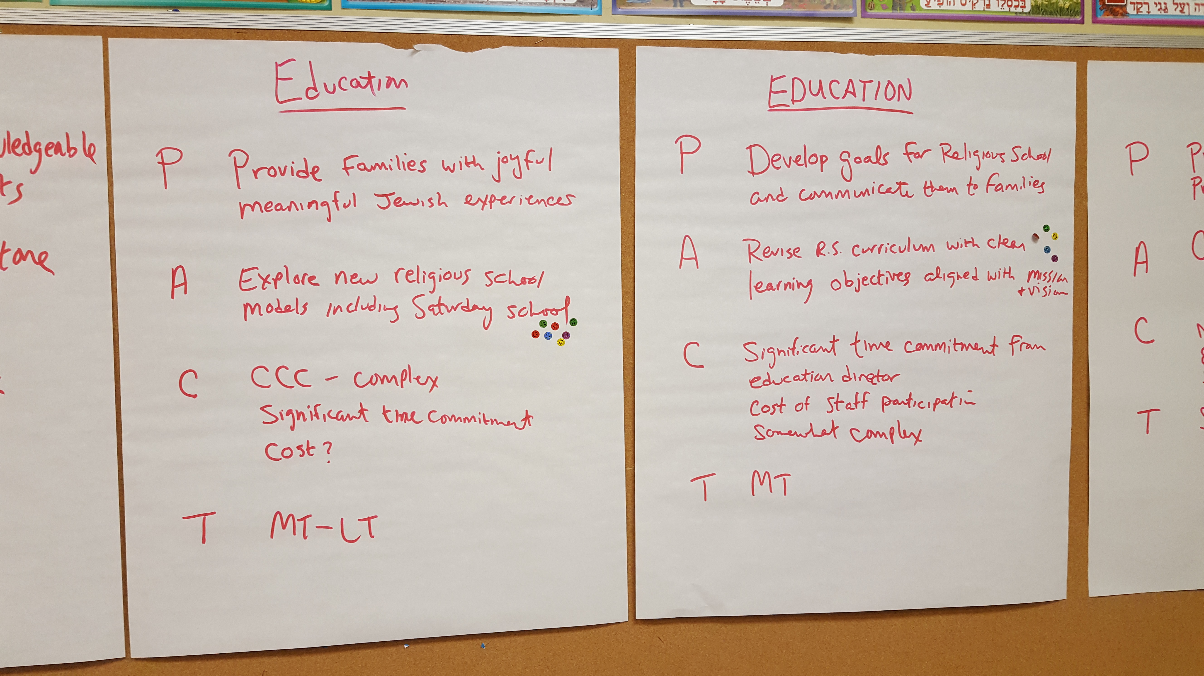
Option: Create Some PACT Goals
Purpose
Why?
Action
What?
Capacity
Who?
How much?
How complex?
Timeframe
When?
Notes:
Look around the room at the pages on the wall… This represents the results of the work that you’ve been doing for the past year!
PACT format will help us make decisions about how to prioritize.
We begin with the WHY. That’s from the TF VISION. Unless it connects to the VISION, it’s just a list of action items, not a strategic plan.
We also need to answer some other key questions: Who? How much? How complex? When?

Slide 23
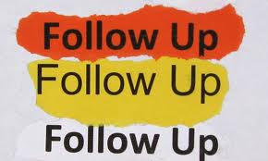
Explain Follow Up 5 minutes
Facilitator types up all sheets and distributes. This is Mission 1.0
Committee or Team for each focus area will follow up on task work
Create PACT goals to make mission a reality in their areas.
Consider studying a text on one of your key vision categories each month.

