Slide 1
Situation and SWOT Analysis 2019
Robert Leventhal – USCJ Leadership Specialist

Slide 2
Why do a SWOT? To get the “lay of the land”
An Honest Assessment of the Current Situation
Identify what is working well, so that you can do more of it
Strengthen underdeveloped areas
Identify weaknesses and limit things that are hurting the kehilla (congregation)
Develop Foresight - Anticipate the Future
Scan the environment to see future trends, factors and forces that will impact your kehilla
Develop plans to take advantage of helpful opportunities
Minimize harmful external forces (threats)

Slide 3
Describing the Current Situation Initial SWOT Exercise
Internal- forces, trends and factors inside the synagogue that impact our future. | Strengths What do we do well? | Weaknesses Where can we improve?
External- forces, trends and factors outside of the synagogue that impact our future. | Opportunities What changes are taking place in our environment that might allow us to better achieve our mission? | Threats What changes in the environment do we need to be aware of or prepare for in doing our work?

Slide 4
Text 1: Numbers 14 Should I Stay or Should I Go?
¹ The whole community broke into loud cries, and the people wept that night. ²All the Israelites railed against Moses and Aaron. “If only we had died in the land of Egypt,” the whole community shouted at them, “or if only we might die in this wilderness! ³Why is the Lord taking us to that land to fall by the sword? Our wives and children will be carried off! It would be better for us to go back to Egypt!” ⁴And they said to one another, “Let us head back for Egypt.”

Slide 5
Pre-Work for SWOT: Data Gathering
Fact Book Exercise Thriving Congregations Assessment

Slide 6
Pre Work: Building a Fact Book: What do we need to know? What can we get?
Internal Scan
Attendance
Membership by age, years as members
Enrollment in schools
Attendance at programs and services
Satisfaction
Parlor meetings- surveys
Fundraising by event
External Scan
Demographics trends
Competition
Economics of area
Lifestyle of community
Competitive substitutes
Schools
You may take this info from a placement application
Studies, articles, interviews about outside community,
Jewish trends, other kehillot
Contact your KRM for
the SSP Fact Book

Slide 7

Pre Work: Thriving Congregation Assessment Have Planning Committee/ Team and Board Complete
Debrief Process
Have all participants do the following:
Mark significant areas of strength with check mark
Mark significant areas of concern with a question mark- these deserve further study in SSP

Slide 8

Pro Tip #1: Be Specific
Rather than…
“Strong School”
Try the following…
“Award winning school, recognized for use of technology. Hebrew tutoring available with Israeli tutors on Skype. Teachers went for extensive training last year.”
“Got Solomon Schecter award for cooperative learning program for 6th grade.”

Slide 9

Pro Tip #2: Be Honest & Hopeful
Honest Assessment- Is the soil fertile?
Hopeful Forward Looking- Spies must bring back fruit

Slide 10
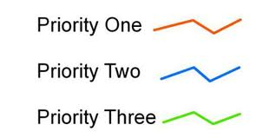
Pro-Tip #3: Prune List of Strengths & Weaknesses and Prioritize Them
Small Weakness- social hall needs new carpet
Big Weakness- lack diversity of services to meet members’ needs
Big Strength- 60% of religious school students stay through high school
Small Strength- great book club

Slide 11
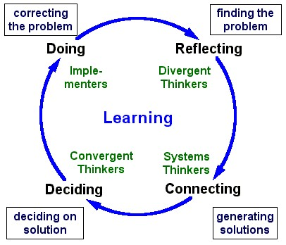
Pro Tip #4: Consider Doing Multiple SWOT Analyses
Initial SWOT done by planning committee as Team Building Reflection. Edited version is SWOT 2.0.
SWOT 3.0- Includes feedback from the Board, connects them to process.
Edited version SWOT 4.0 helps task forces decide what to work on.
Have task forces do a SWOT for their focus area
Source: Based on “The Wheel of Learning –
The Fifth Discipline” (Senge)

Slide 12
Opportunities

Slide 13
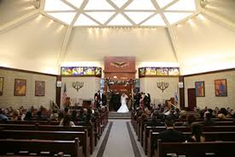
Opportunities: Promotion Remind stakeholders that synagogues matter
While overall the number of Conservative and Reform households continues to decline, for Conservative and Reform Jews, affiliation makes a huge difference in the level of engagement.
Nearly three quarters (73%) of Conservative Jews who are members of a congregation have high or very high levels of Jewish engagement, compared with less than 15% of Conservative Jews not affiliated with a congregation.
UJA Executive Summary p.27
Dix Hills Jewish Center

Slide 14

Opportunities: Partnerships
Welcome to the Jewish Journey Project (JJP)
JJP provides participants—from 3rd to 7th grades—with rich opportunities to engage in extensive educational opportunities outside of the classroom, making use of the vast Jewish resources of our great city of New York.
Other partners, agencies, local universities

Slide 15
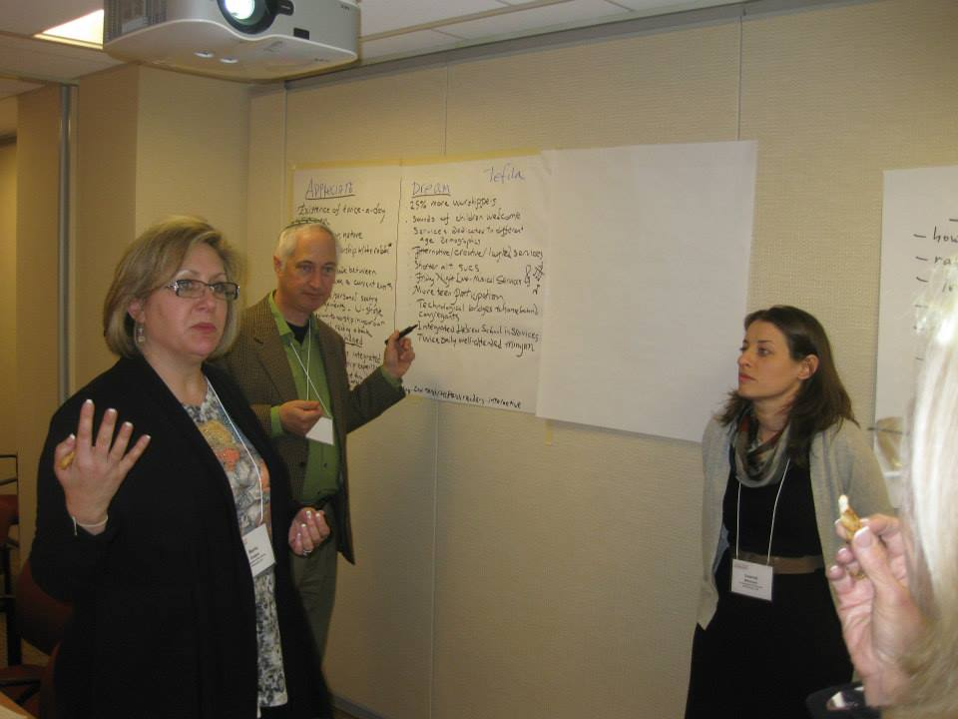
Conducting SWOT Workshop

Slide 16
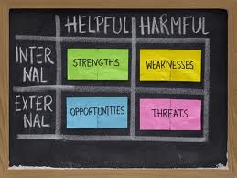
SWOT Exercise 60 Minutes
Trigger Text: The Spies 10 minutes
Review Fact Book 15 minutes
Conduct the SWOT 30 minutes
Strengths to Possibilities 10 minutes

Slide 17
Conduct SWOT Exercise
Strengths (Left) Great facility- Renovated 5 years ago. Prime location near the JCC and major Jewish neighborhoods. Award winning religious school. Has new computer lab. Received awards for cooperative learning. | Weaknesses (Right) Housing costs are rising. Some families are having to move 20 minutes away. With traffic it can be 30 minutes. Have to compete with children’s sports on Sundays. Those who live farther out have poor attendance.
Whole Group- 30 minutes
The planners will take two (2) pages and make entries into each section.
Use as many sheets as needed.
Strength (Left)
Weakness (right)
Finish Strengths and Weaknesses before you do Opportunities and Threats.

Slide 18
Connect Strengths to Possibilities
Strengths Great facility- Renovated 5 years ago. Prime location near the JCC and major Jewish neighborhoods. Award winning religious school. Has new computer lab. Received awards for cooperative learning. | Possibilities Invite some independent minyanim to use great facility. Increase business for caterer. Social hall fees. Create more opportunties for on line learning and small team projects that can be done off site.
“Connect Strengths to Possibilities”

Slide 19
Next Steps Ask KRM for Fact Book and Link to TCA Conduct TCA with SC and Board Debrief Data with Board Plan SWOT Exercise with Board

